Slide 1
Automation of Stock Monitoring System
Final Year Project Presentation
on

Slide 2
Presented By: Group number 11
Name PRN Number
1.Suraj S Jadhav 181IT2607086
2.Nikhil N Dhoble 181IT2607082
3.Swapnil V Dake 181IT2107081
4.Sushant U Godbharle 181IT2607084
5.Shubham R Sontakke 181IT2607092
Under the Guidance of
Prof. S. D. Rane Prof. (Dr).D.V.Kodavade Prof.(Dr.)P.V.Kadole (Project Guide) (H.O.D) (Director)

Slide 3
Content
Abstract
Introduction
Requirements Analysis
Existing System
Architecture
Module Identification

Slide 4
Abstract
This System works with image processing for adding the stock and removing the stock of products in warehouse.
This system generates overall day to day report without any error automatically.
The project Automation of Stock Monitoring System is designed to handle the warehousing stocks and this software application maintain the records that include good stock going in and out and other related issues. Features included in it Automated ordering of grocery stock and analysis of all data without using manual work. This system generates overall day to day report without any error automatically

Slide 5
Introduction
This desktop application is based on the management of stock of an organization. The main aim of the project is to develop Inventory Management System Model software in which all the information regarding the stock of the organization will be presented. The application contains general organization profile, sales details, Purchase details and the remaining stock that are presented in the organization.
Here the login page is created in order to protect the management of the stock of organization in order to prevent it from the threads and misuse of the inventory.

Slide 6
Requirement Analysis
Functional requirements:
1. User Interface requirements
1. Admin should be able to register him/her on the application.
2. Owner has add order, delete order authority.
3. User should be capable to see old data any time.
4. Search inventory, details of inventory should be provided.
5. Scanned data is added automatically in database.
6. It allows admin to generate details report.
7. It allows admin to generate stock statement report.
8. It allows any user to logout when he wants to come out from the system.

Slide 7
2 Software interface requirements :
1.Python – it used for develop and deploy the frontend code.
2. Windows os platform- to develop and run the System.
3. Pycharm- To test the code.
4. Cmd-To install the required packages
5. Xampp- for storing database details

Slide 8
Existing System
In todays system we requires many persons on the different departments like, to calculate the weight of stock, to write the detailed data about stock and many more manual work.
Disadvantages
Peoples tends to make error in manual data entry.
Efficiency and accuracy is not expected.
Time consuming and slow processing.

Slide 9
Problem Statement
Implement a system which monitoring of stock.

Slide 10
Objectives
To develop an application that deals with day to day requirement any production organization .
To handle the inventory details like sales details, purchase details and balance stock details.
To provide details information about the stock balance.

Slide 11
Modules
Image Recognition
Object matching
Report Generation

Slide 12
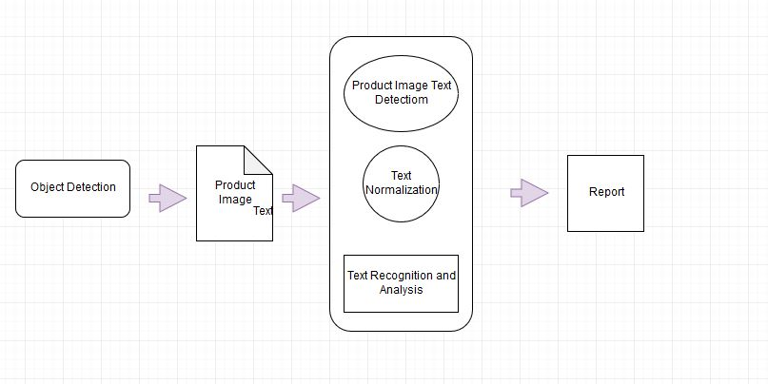
System Architecture

Slide 13
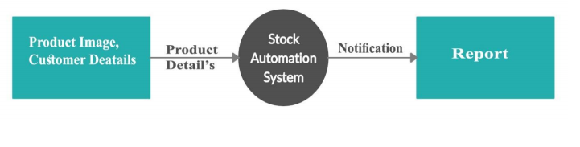
Data Flow Diagram Level-0

Slide 14
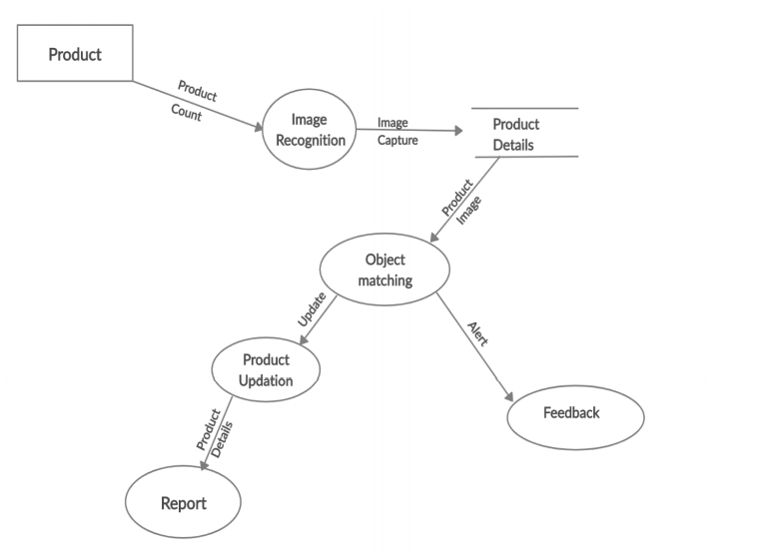
Data Flow Diagram Level-1

Slide 15
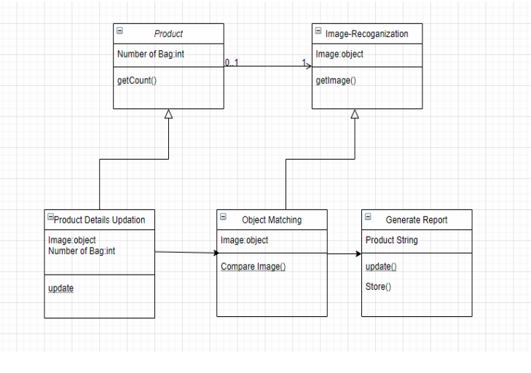
Class Diagram

Slide 16
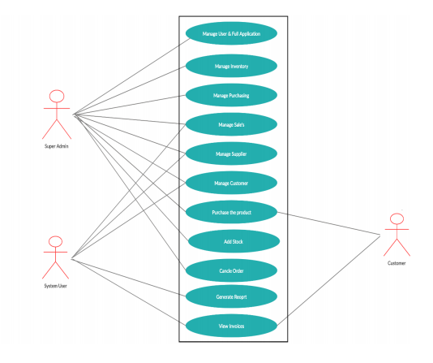
Use Case Diagram

Slide 17
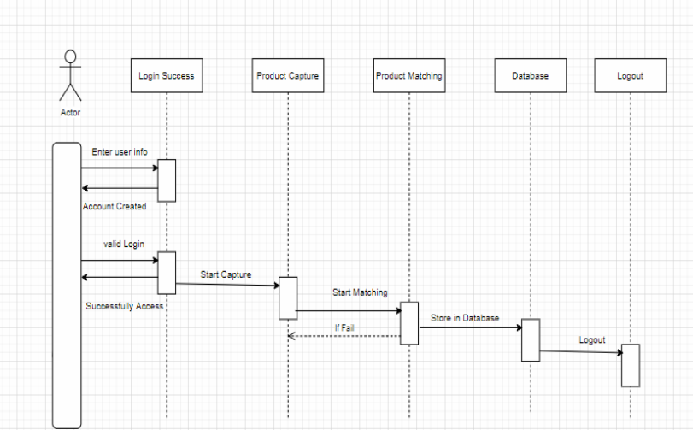
Sequence Diagram

Slide 18
Applications
Platform for solving Manual issues.
User can help to store all details easily .
Under supervision of supply, storage and accessibility of items is possible.
Day to day report is generated.
Accuracy of data.
Used in grocery ware house.
Used in textile industry.
Used in small shops also.

Slide 19
Reference
Technical White Paper, Warehouse Management in Dynamics NAV 2013.
Serhii Z, “A literature review on models of inventory management under uncertainty” (2015).
P.G. Matsebatlela and K. Mpofu, “Inventory Management Framework to Minimize Supply and Demand Mismatch on a Manufacturing Organization”, International Federation of Automatic Control, Vol.3, No.48, Mar 2015, pp-260- 265.
https://ieeexplore.ieee.org./document/8065839

Slide 20
Thank You…

